Slide 1
AZ-104 PROJECT REPORT
Team 189 | Project 087
Azure Chaos Studio Resilience Experiment
Validating High Availability and Simulating Zone Failures in Microsoft Azure Architecture
DOMAIN
COURSE CONTEXT
Microsoft Azure
Cloud Infrastructure & Chaos Engineering
Azure Administrator (AZ-104)

Slide 2
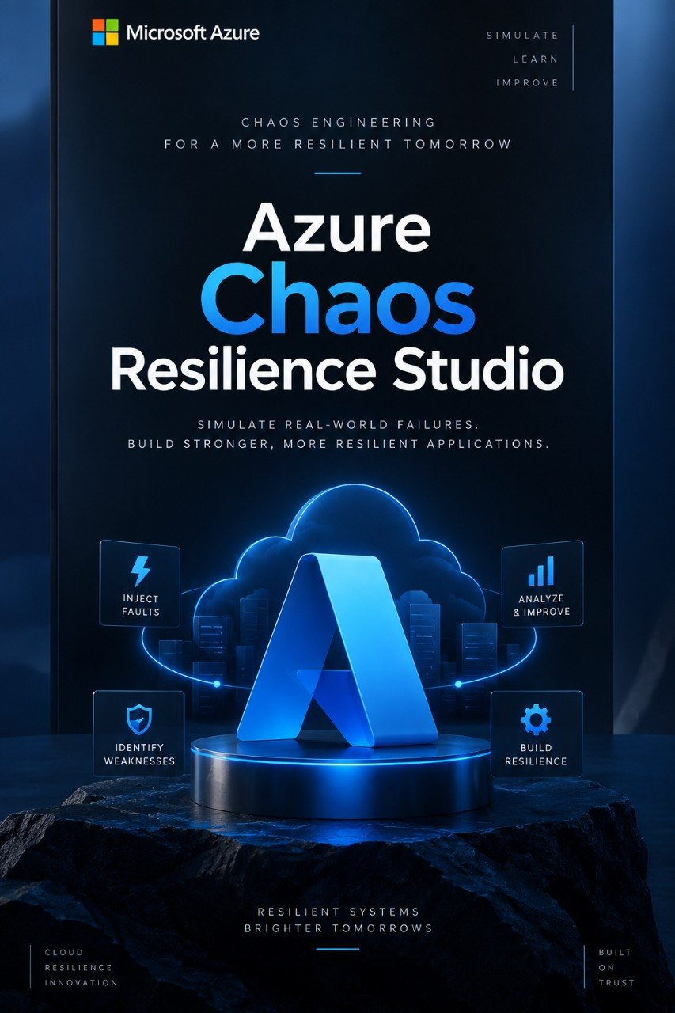
EXECUTIVE OVERVIEW
Project Abstract & Certification Goals
AZ-104 Framework
Practical Problem Solving
Demonstrates practical solution engineering on Azure to solve real-world availability challenges rather than relying solely on theory.
Hands-On Exploration
Integrates key Azure services into a cohesive environment to evaluate performance under fault injection scenarios step-by-step.
Iterative Solutioning
Identifies technical hurdles during fault execution, researches remediation steps, and applies cloud management best practices.

Slide 3



CORE CHALLENGE
Problem Statement
"Designing high-availability architecture alone does not guarantee resilience during real-world cloud infrastructure outages."
Controlled Zone Failure
Traffic Failover
Recovery Speed
Injecting faults safely into an active zone using Azure Chaos Studio.
Verifying if redundant resources maintain user request handling.
Measuring total recovery time and validating health monitoring integrity.

Slide 4




PROJECT GOALS
Core Project Objectives
1. Requirements Analysis
2. Azure Service Evaluation
Understand architectural demands for zone resilience.
Identify optimal cloud resources for resilience testing.
3. Architectural Design
4. Resource Management
Design multi-zone fault-tolerant cloud topology.
Gain hands-on provisioning and agent setup skills.

Slide 5
SCOPE & APPLICATIONS
Target Azure Use Cases
Compute & Storage
IAM & Governance
Monitoring & Security
App Hosting: Deploying cloud workloads across Availability Zones.
User Management: Role-based access control (RBAC) setup.
Health Tracking: Azure Monitor application health metrics.
VM Management: Configuring scale sets and virtual machines.
Resource Scope: Restricting chaos experiment execution bounds.
Backup Services: Recovery point restoration validation.
Cloud Storage: Redundant storage account configurations.
Permissions: Assigning managed identity permissions.
Security Rules: Safe failure testing without side effects.

Slide 6


PREREQUISITES
System Requirements
Software Requirements
Hardware Requirements
Microsoft Azure Portal: Cloud management dashboard.
Host Workstation: Laptop or Personal PC.
Modern Web Browser: Edge / Chrome / Firefox.
Memory Capacity: Minimum 8 GB RAM.
Azure Account Access: Active subscription with RBAC rights.
Display Resolution: Standard HD screen for Portal monitoring.
Internet Connection: High-speed stable network connection.
Connectivity: Continuous network bandwidth for remote telemetry.

Slide 7
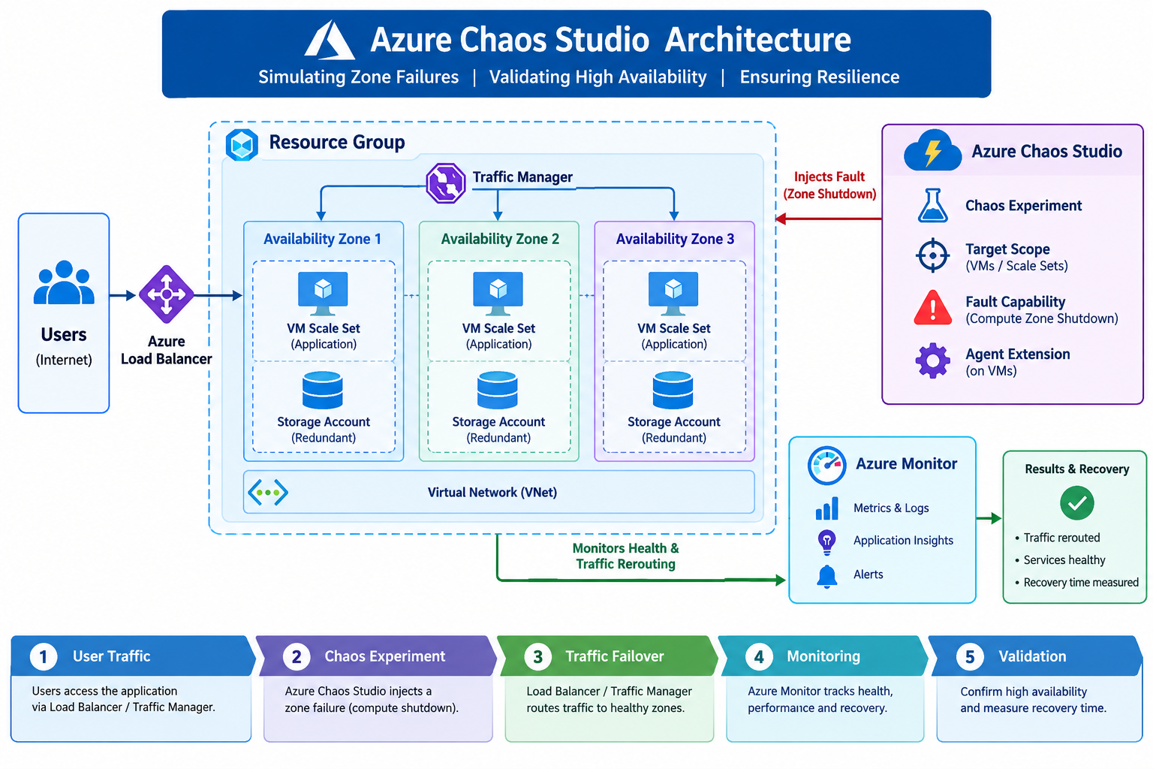
TECHNICAL DESIGN
Azure Chaos Studio Architecture
Chaos Target Scope
Isolating target Virtual Machines and scale sets inside an explicit Resource Group boundary.
Fault Capabilities
Executing Compute Zone Shutdown actions to simulate complete Availability Zone failure.
Health Monitoring Integration
Observing traffic rerouting through Load Balancer / Traffic Manager using Azure Monitor.

Slide 8
EXECUTION MODEL
6-Step Implementation Methodology
1
6
2
3
4
5
Study Requirements
Document Findings
Analyze & Select
Design Solution
Provision Resources
Test & Observe
Understand expected resilient outcome.
Prepare high-availability blueprint.
Run fault experiment & record metrics.
Report resilience gaps & refine.
Identify required Azure services.
Create targets in Azure Portal.

Slide 9
RISK & IMPLEMENTATION ANALYSIS
Identified Project Challenges
Experiment Scoping
RBAC Permissions
Defining exact resource boundaries to prevent blast radius spillover.
Assigning managed identity roles on target resources securely.
Agent Configuration
Safety Constraints
Configuring Chaos Studio agent extension across Virtual Machines.
Ensuring fault injection tests run safely without affecting unrelated systems.

Slide 10

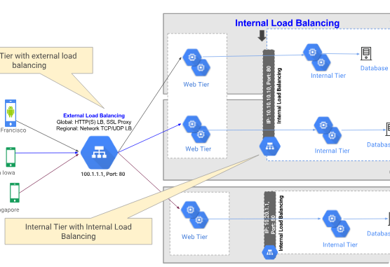
TARGET IMPACT
Expected Project Outcomes
Cloud Concepts Mastery
Deeper understanding of distributed resilience patterns.
Practical Exposure
Direct experience configuring Azure Chaos Studio.
Resource Management
Improved capability in managing production cloud assets.

Slide 11
PROJECT ROSTER
Team 189 Contributor Roster
Project No. 087
VT
GH
TS
VG
Vattigunta Lakshmi Triveni
Gollapalli Hanshika Naaga Devi
Thatikonda Sai Prasanna
Veeramreddy Geetha Pramodha Reddy
2400031813
2400031763
2400031711
2400080243

Slide 12
CURRENT STATUS & CONCLUSION
Initial Stage Focus & Next Steps
Focusing on scope definition and initial design planning through a structured, sequential approach to acquire real-world Azure capabilities.
Team 189
Thank You / Questions?

